Slide 1
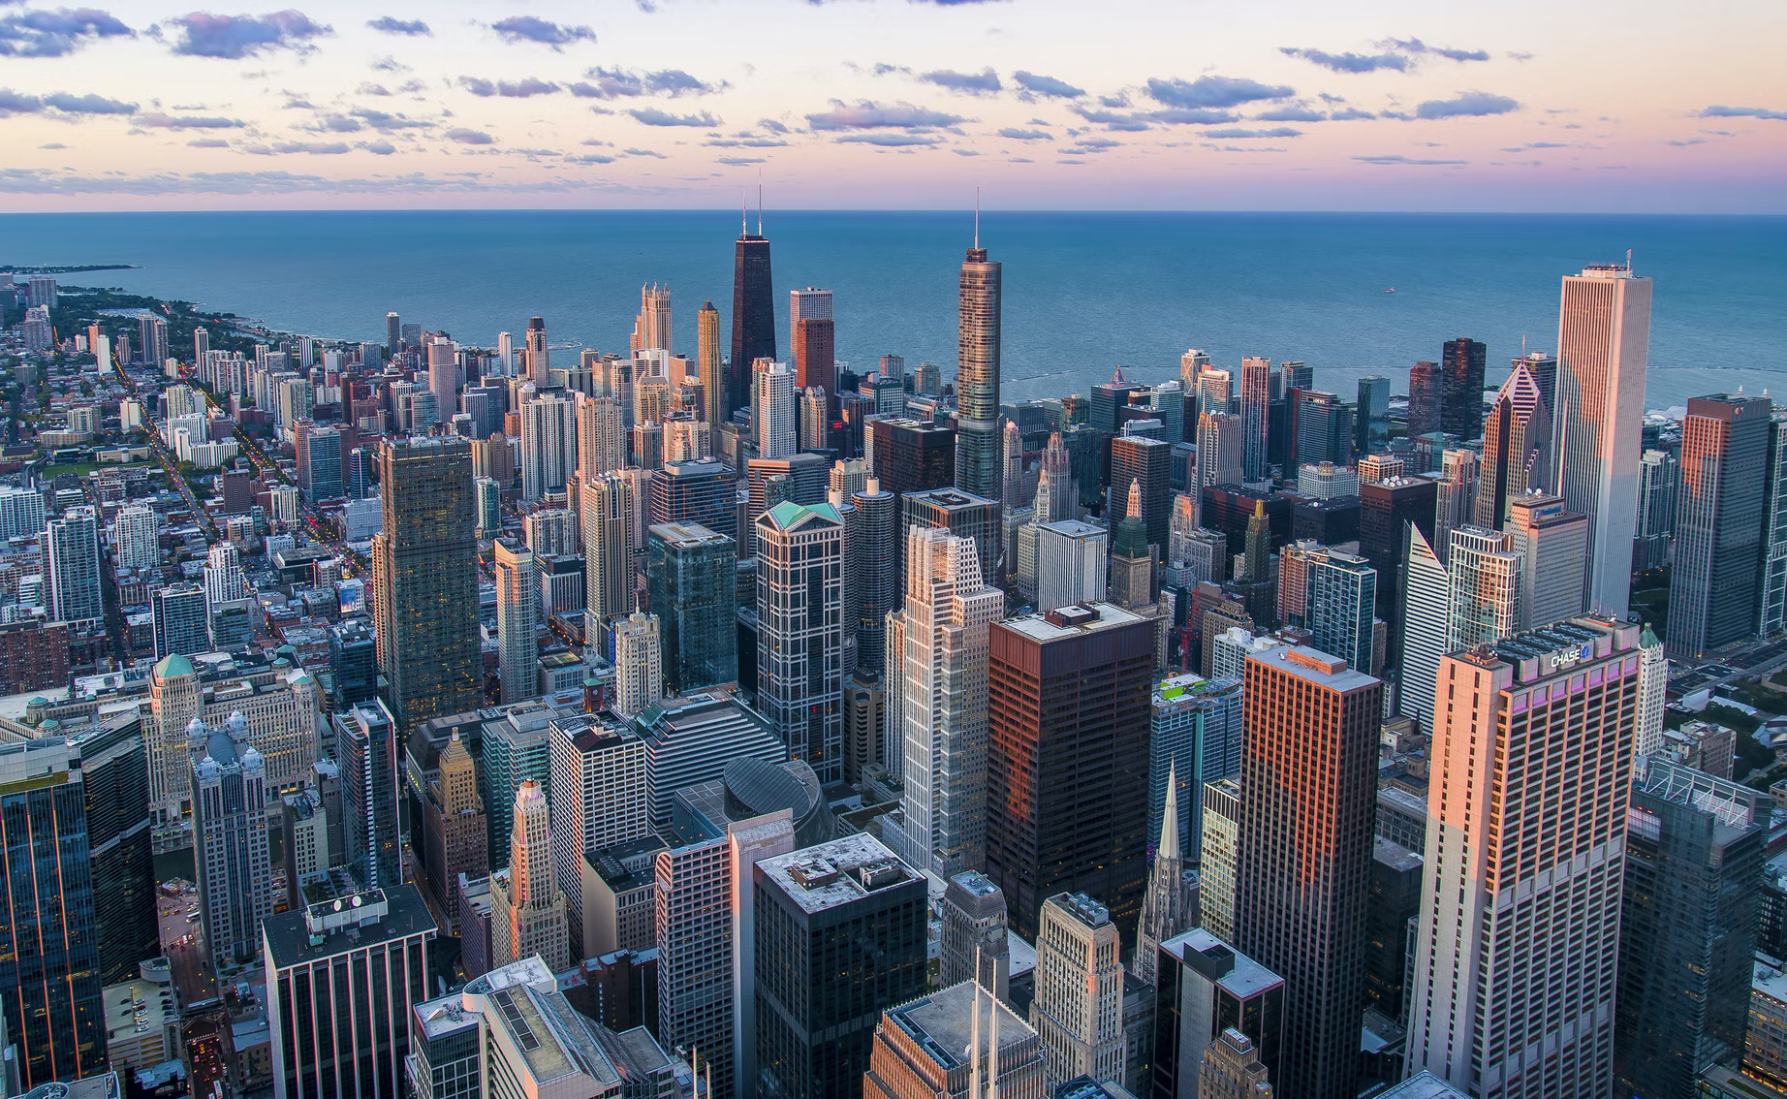
DATA ANALYTICS VISUALIZATION
FINAL PROJECT PORTFOLIO
MUHAMMAD WAHFIUDDIN PRADIWA

Slide 2
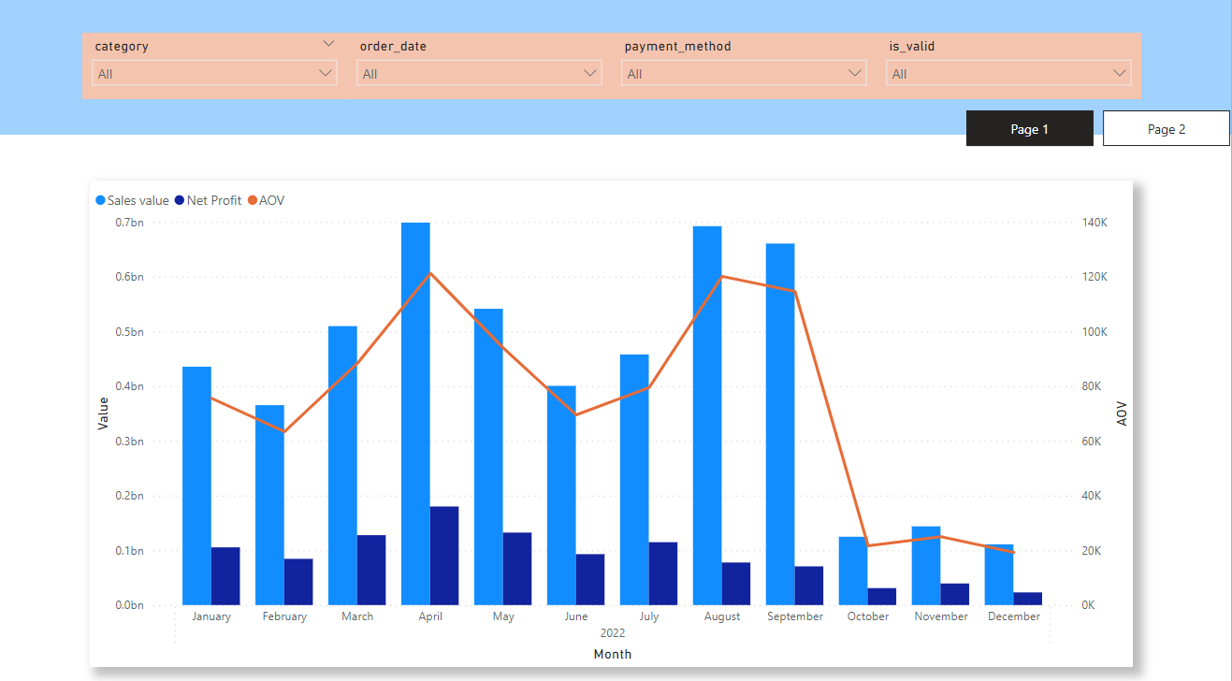
QUESTION 1

Slide 3
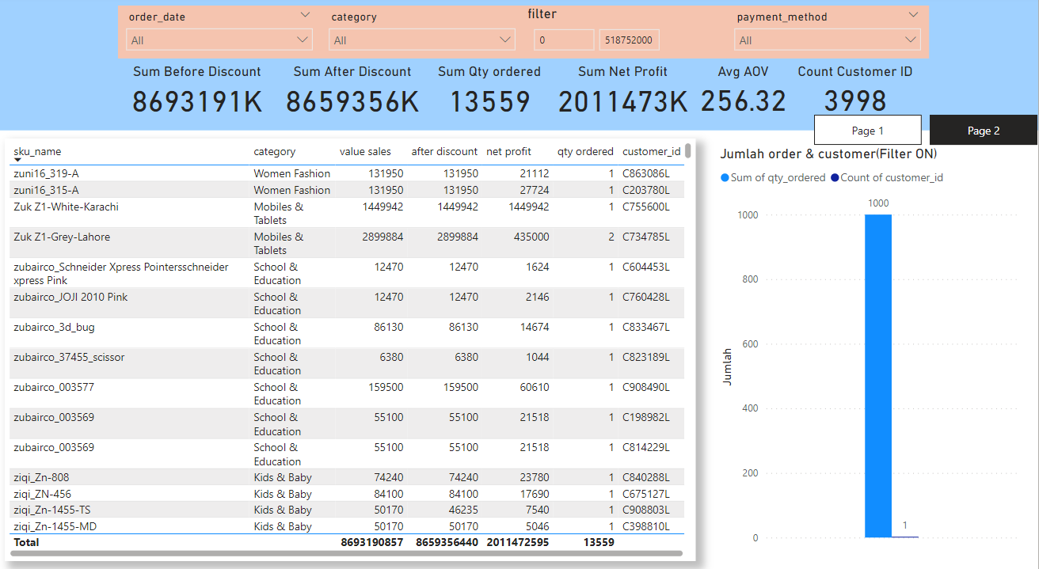
QUESTION 2

